Slide 1

Analyzing Amazon Sales Data
Made By:
Prachi Mehta

Slide 2


Problem Statement
Sales management has gained importance in meeting increasing competition and the need for improved distribution methods to reduce costs and increase profits. Sales management today is the most important function in a commercial and business enterprise. The task is to analyze the sales data and find solutions that help the company increase its sales by reducing costs and increasing profits.
Software Used
Tableau Public

Slide 3

Dataset
The dataset contains a total of 100 records.
Dataset Columns:
Region: Geographical region where the sale took place.
Country: Specific country within the region where the sales took place.
Item Type: Types of items sold (Baby Food, Vegetables, Cereals, etc.)
Sales Channel: Method of sale (Online / Offline)
Order Priority: Priority of the order (High, Medium, Low)
Order Date: Date when the order took place
Order ID: Unique identifier of each order
Units Sold: Number of units sold in each order
Unit Price: Price per unit of the items sold
Unit Cost: Cost incurred per unit for an item
Total Revenue: Total Revenue generated from the order
Total Cost: Total Cost incurred for the order
Total Profit: Profit earned from the order

Slide 4

Data Cleaning
The data cleaning process was done using MS Excel. To make the dataset accurate, consistent, and ready for analysis, the steps taken are:
To maintain data integrity and accuracy in analysis, we have ensured that all the duplicate records are removed, and all the records are unique.
Converted the date columns to a consistent dd/mm/yyyy format to maintain data uniformity and easy analysis.
Changed the order priority column values from abbreviations (H, M, L) to easy-to-read labels to ensure better readability and understanding (High, Medium, Low).

Slide 5
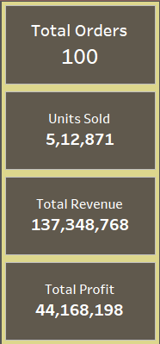
Key Performance Indicator (KPI)
Total Orders: The total number of orders placed during the analyzed period indicates the number of transactions and overall customer demand.
Units Sold: The total number of individual items sold across all orders which helps to reflect the scale of product movement and sales volume.
Total Revenue: The total income generated from all the orders. It helps to measure the financial performance and the business’s ability to generate income.
Total Profit: The total profit earned from all the orders which gives insight into the business’s profitability and financial health.

Slide 6
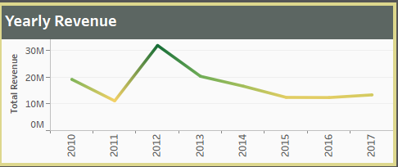
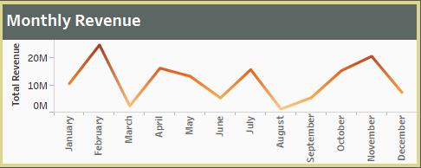
Sales Trends Over Time
The year 2012 has found to be the highest revenue of a total of 3,18,98,614 and aligning with this strong yearly performance February month has also been with the highest revenue of a total of 2,47,40,518.
There was a noticeable decline in both yearly and monthly revenue after 2012. This can be due to a shift in market dynamics or internal factors affecting sales.
Monthly sales reached a high point in February and again towards the month of November which can indicate seasonal buying patterns which are mostly tied to holidays and promotional periods.
From the year 2015 to 2017, we can see the revenue has been consistent but lower performance which concludes that there is a need for strategic interventions required to boost growth.
Lowest revenue is in the month of August with total revenue of 11,28,165 which can be due to off-season, or we need to have better marketing strategies.

Slide 7
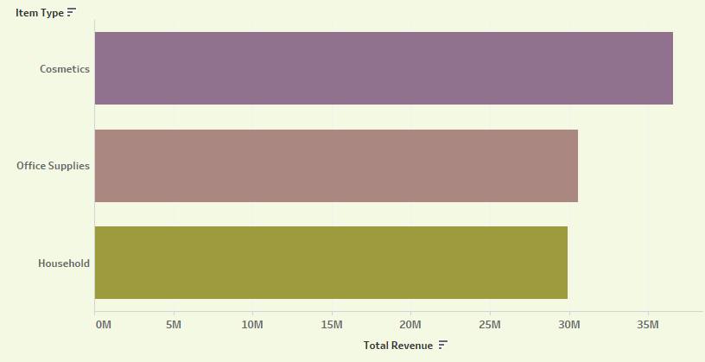
Product Performance Analysis
Some of the best-performing products that have the maximum units sold and generated maximum revenue and profits are:
Cosmetics: A total of 83,718 units were sold out of which the total revenue generated was 3,66,01,510 and a total profit was 1,45,56,049.
Office Supplies: 46,967 total units were sold out of which total revenue generated was 3,05,85,380 and the total profit made was 59,29,584.
Household: A total of 44,727 units were sold out of which total revenue generated was 2,98,89,712 and the total profit made was 74,12,606

Slide 8
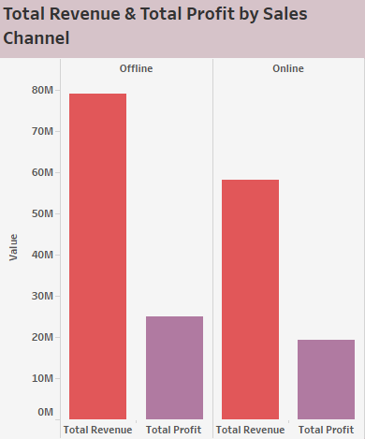
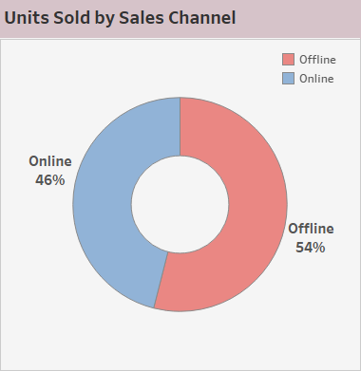
Sales Channel Analysis
54% of units were sold through the offline sales channels whereas 46% were sold through the online sales channels.
In terms of unit sales, even though online sales are significant offline sales hold a majority which reflects the importance of physical stores and direct sales methods.
The offline sales channel generates more total revenue and profit as compared to the online sales channel.
Offline sales channels remain more profitable despite the growth of e-commerce which can be due to higher-priced items, bulk purchases, or more effective sales strategies in physical locations.

Slide 9
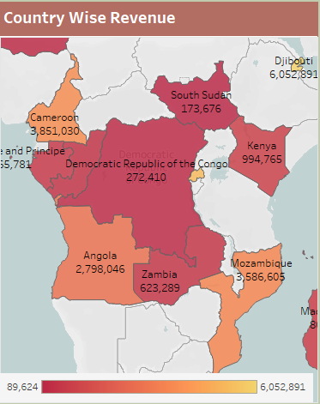
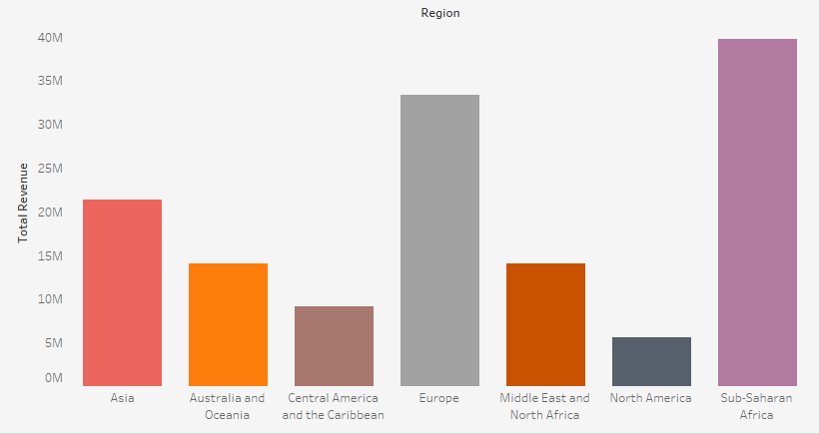
Regional Sales Distribution
Sub-Saharan Africa is been the top-performing region where 1,82,870 units are sold generating a total revenue of 3,96,72,031.
Within this region, Djibouti is been the top-performing country which sold a total of 23,198 units and generated a total revenue of 60,52,891.
With the strong performance in this region, there is potential growth and investment.
The North American region has sold the lowest units and generated the lowest revenue which indicates that there is a need to analyze market conditions, competition, or strategies that may impact the performance in this region.

Slide 10
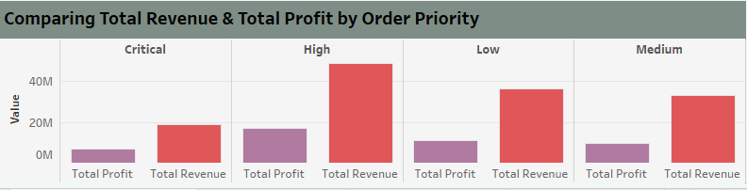
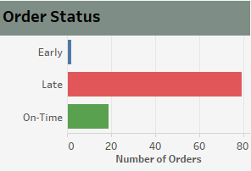
Order Priority Analysis
High-priority items generated the most revenue and profit as they are important for financial performance and critical items generated the least revenue and profit as they need reevaluation in terms of pricing or sales strategy.
There were only 2 orders that arrived early, 79 orders were delivered late, and 19 orders were delivered on time. It shows that there is a significant issue with late deliveries, therefore we need to improve the logistics and order fulfillment process.
There is been a wide range in lead time between the order date and the ship date which shows inconsistencies in the supply chain that require close monitoring and process optimization.

Slide 11
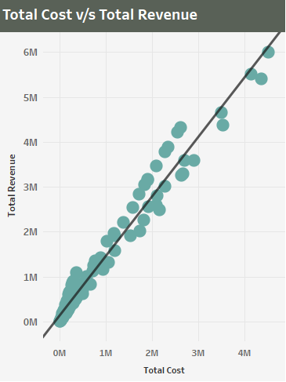
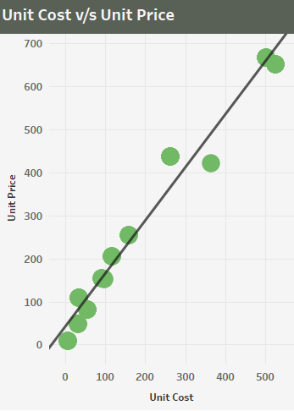
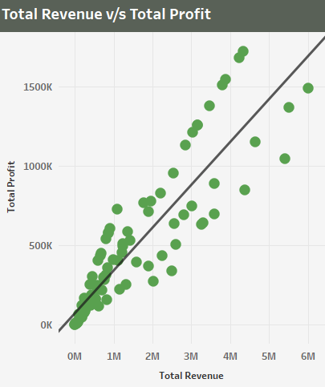
Correlation
Unit Cost & Unit Price:
The R-squared value shows a strong positive linear relationship between unit cost and unit price and an extremely low p-value indicates that this relationship is statistically significant. Therefore, as the unit cost increases the unit price is also set higher to maintain the profit margins.
Total Cost & Total Revenue:
The R-squared value shows a strong correlation between total cost and total revenue which indicates that as total cost increases, total revenue also tends to increase. The lower p-value determines the statistical significance. Therefore, higher sales are associated with higher costs.
Total Revenue & Total Profit:
The R-squared value shows a strong positive relationship between total revenue and total profit and the lower p-value determines the statistical significance. Therefore, as the revenue increases profit also tends to increase.

Slide 12
Strategic Recommendations
To drive future growth, we must focus investment and marketing efforts in top-performing regions like sub-Saharan Africa.
We need to smooth order fulfillment processes by reducing the lead time and minimizing the late deliveries which would help to enhance customer satisfaction and reduce operational costs.
By using targeted digital marketing and improved e-commerce platforms, we can enhance our online sales and hold nearly equal unit distribution between online and offline sales channels.
We must increase our focus on high-priority items to maximize revenue and profit and reconsider the strategy for critical priority items with lower performance.
We must leverage the strong correlations between unit cost and unit price to rectify the pricing strategies that will maximize our profits while staying competitive.

Slide 13
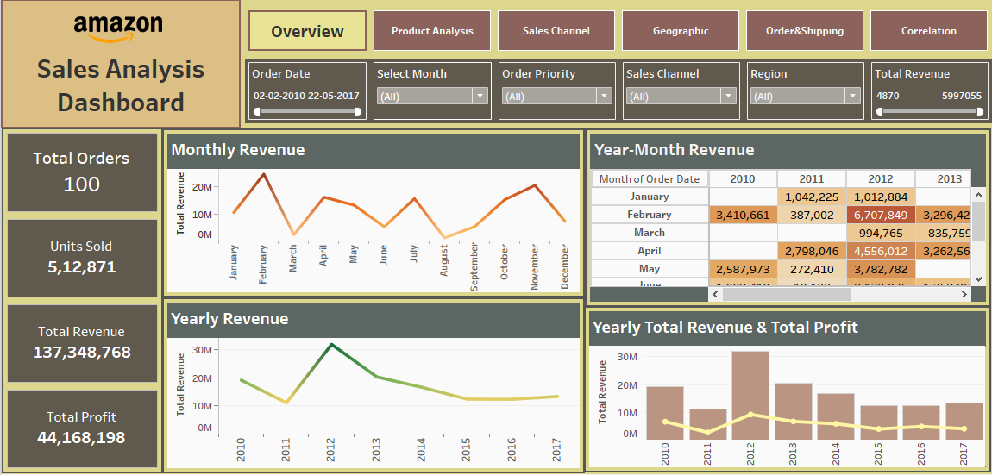
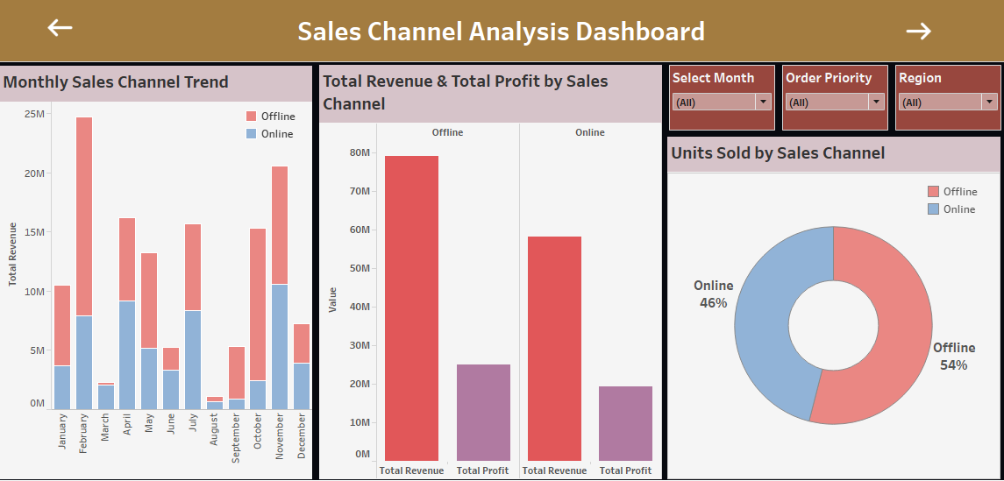
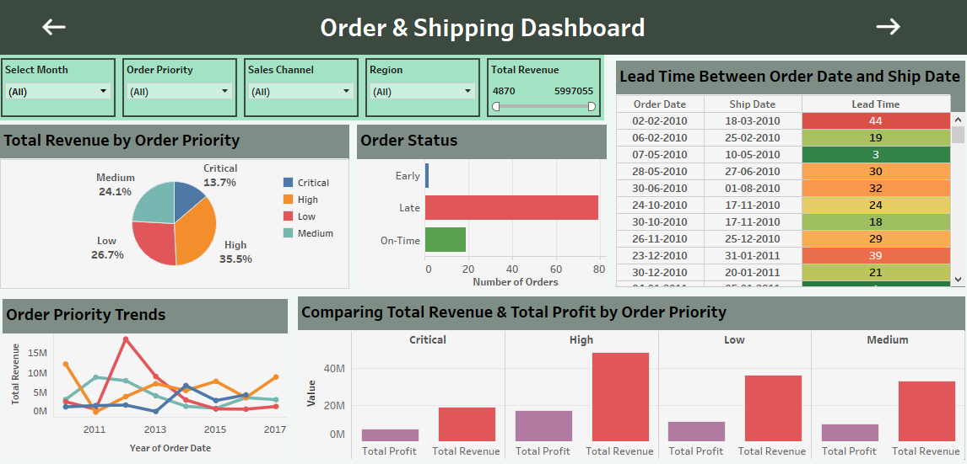
Dashboard Designs

Slide 14
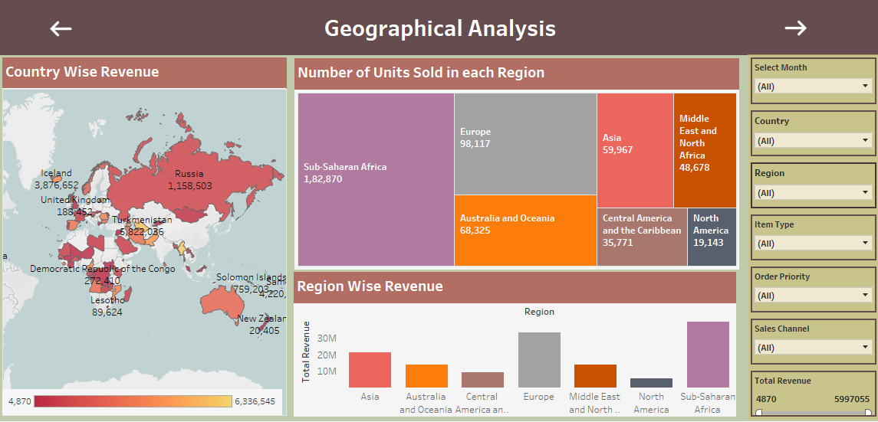
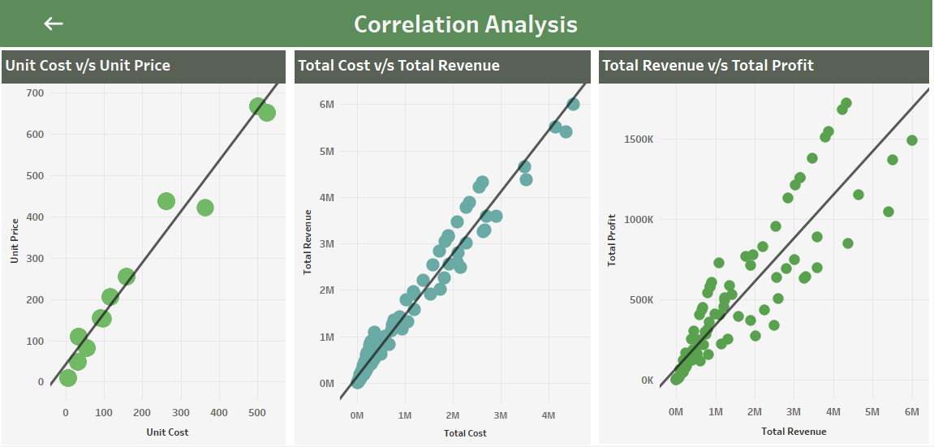
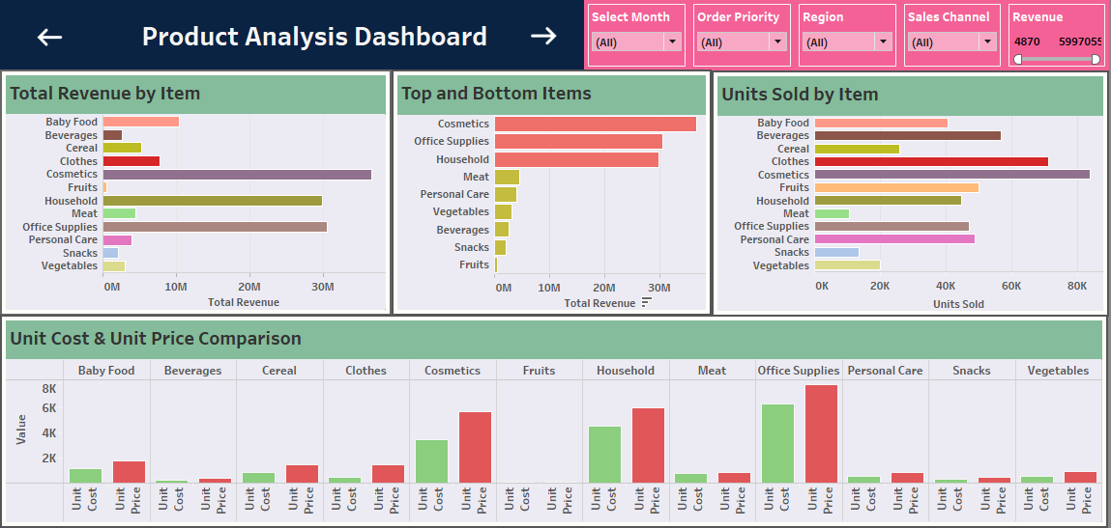

Slide 15
Thank you
Project Link
Https://public.Tableau.Com/views/amazon_sales_analysis_17220832197120/sales_overview?:Language=en-us&publish=yes&:sid=&:redirect=auth&:display_count=n&:origin=viz_share_link

